Slide 1





https://youtu.be/zCRKvDyyHmI
Introduction to circularity
A circular economy is an economic model that minimizes waste by recycling
Presentation by Io Chatzivaryti

Slide 2

Why is the Circular Economy Important?
provides solutions to increasingly pressing environmental challenges, including the depletion of natural resources and the growth of waste that damages ecosystems.
reduce dependence on new raw materials, minimize waste, and reduce carbon emissions, thereby contributing to long-term desirability.
drives new economic opportunities by encouraging innovation, efficiency and job creation in industries that prioritize the recycling and reuse of materials

Slide 3
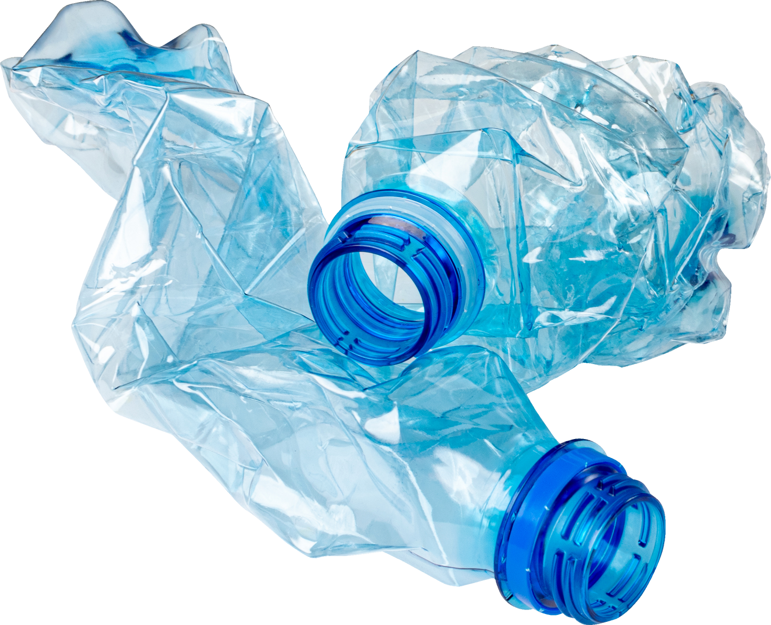
Impact of Waste on the Environment
The fact that plastic waste does not easily decompose naturally makes it a significant contributor to environmental damage and can persist in nature for hundreds of years.
Throwing plastic carelessly, especially in the sea, can result in pollution that is detrimental to marine ecosystems and threatens marine life. Plastic can be mistaken for food by marine animals, causing death by causing a blockage in the digestive tract.
In addition, microplastics formed from plastic degradation can enter the food chain, which can pose a health risk to humans

Slide 4
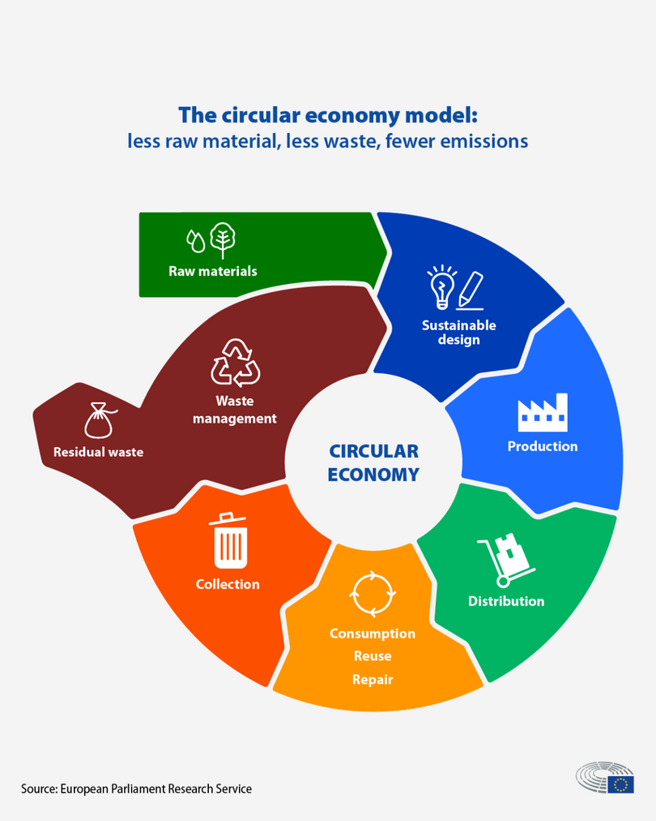
Definition
The circular economy is a model of production and consumption, which involves sharing, leasing, reusing, repairing, refurbishing and recycling of existing materials and products as long as possible. In this way, the life cycle of products is extended.

Slide 5
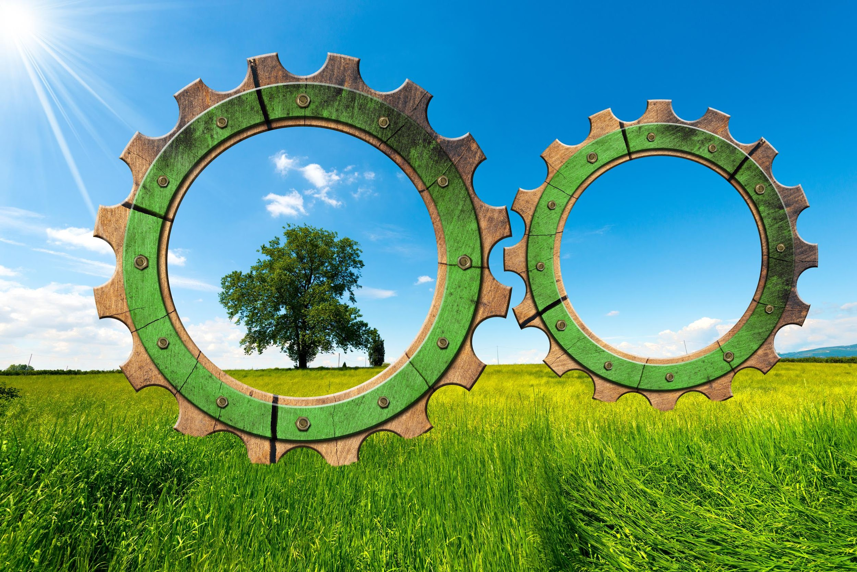
Key Principles of a Circular Economy
3 key interrelated principles form the -reducing waste and pollution,
-extending product life cycles, and
- regenerating natural systems.
The initial principle is to reduce waste and pollution by preventing environmental pollution from the start of design and production. Products and processes are designed to minimize or eliminate waste by considering environmental impact

Slide 6
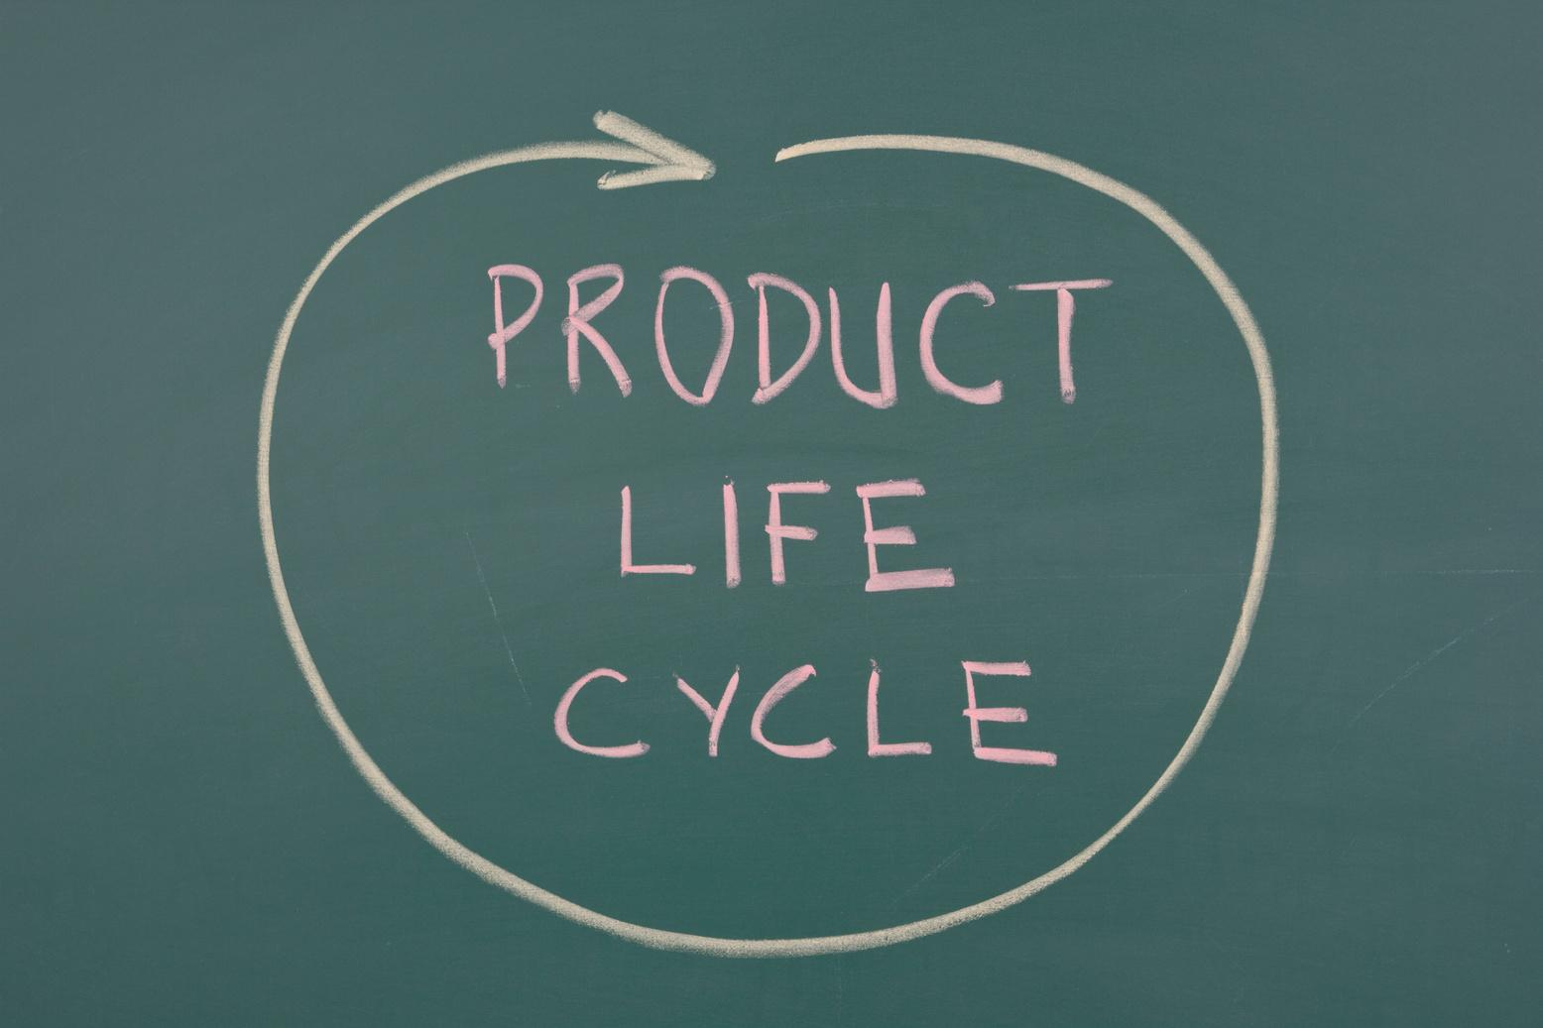
Understanding Circular Economy
In practice, it implies reducing waste to a minimum. When a product reaches the end of its life, its materials are kept within the economy wherever possible thanks to recycling. These can be productively used again and again, thereby creating further value.
This is a departure from the traditional, linear economic model, which is based on a take-make-consume-throw away pattern. This model relies on large quantities of cheap, easily accessible materials and energy.
Also part of this model is planned obsolescence, when a product has been designed to have a limited lifespan to encourage consumers to buy it again. The European Parliament has called for measures to tackle this practice.

Slide 7
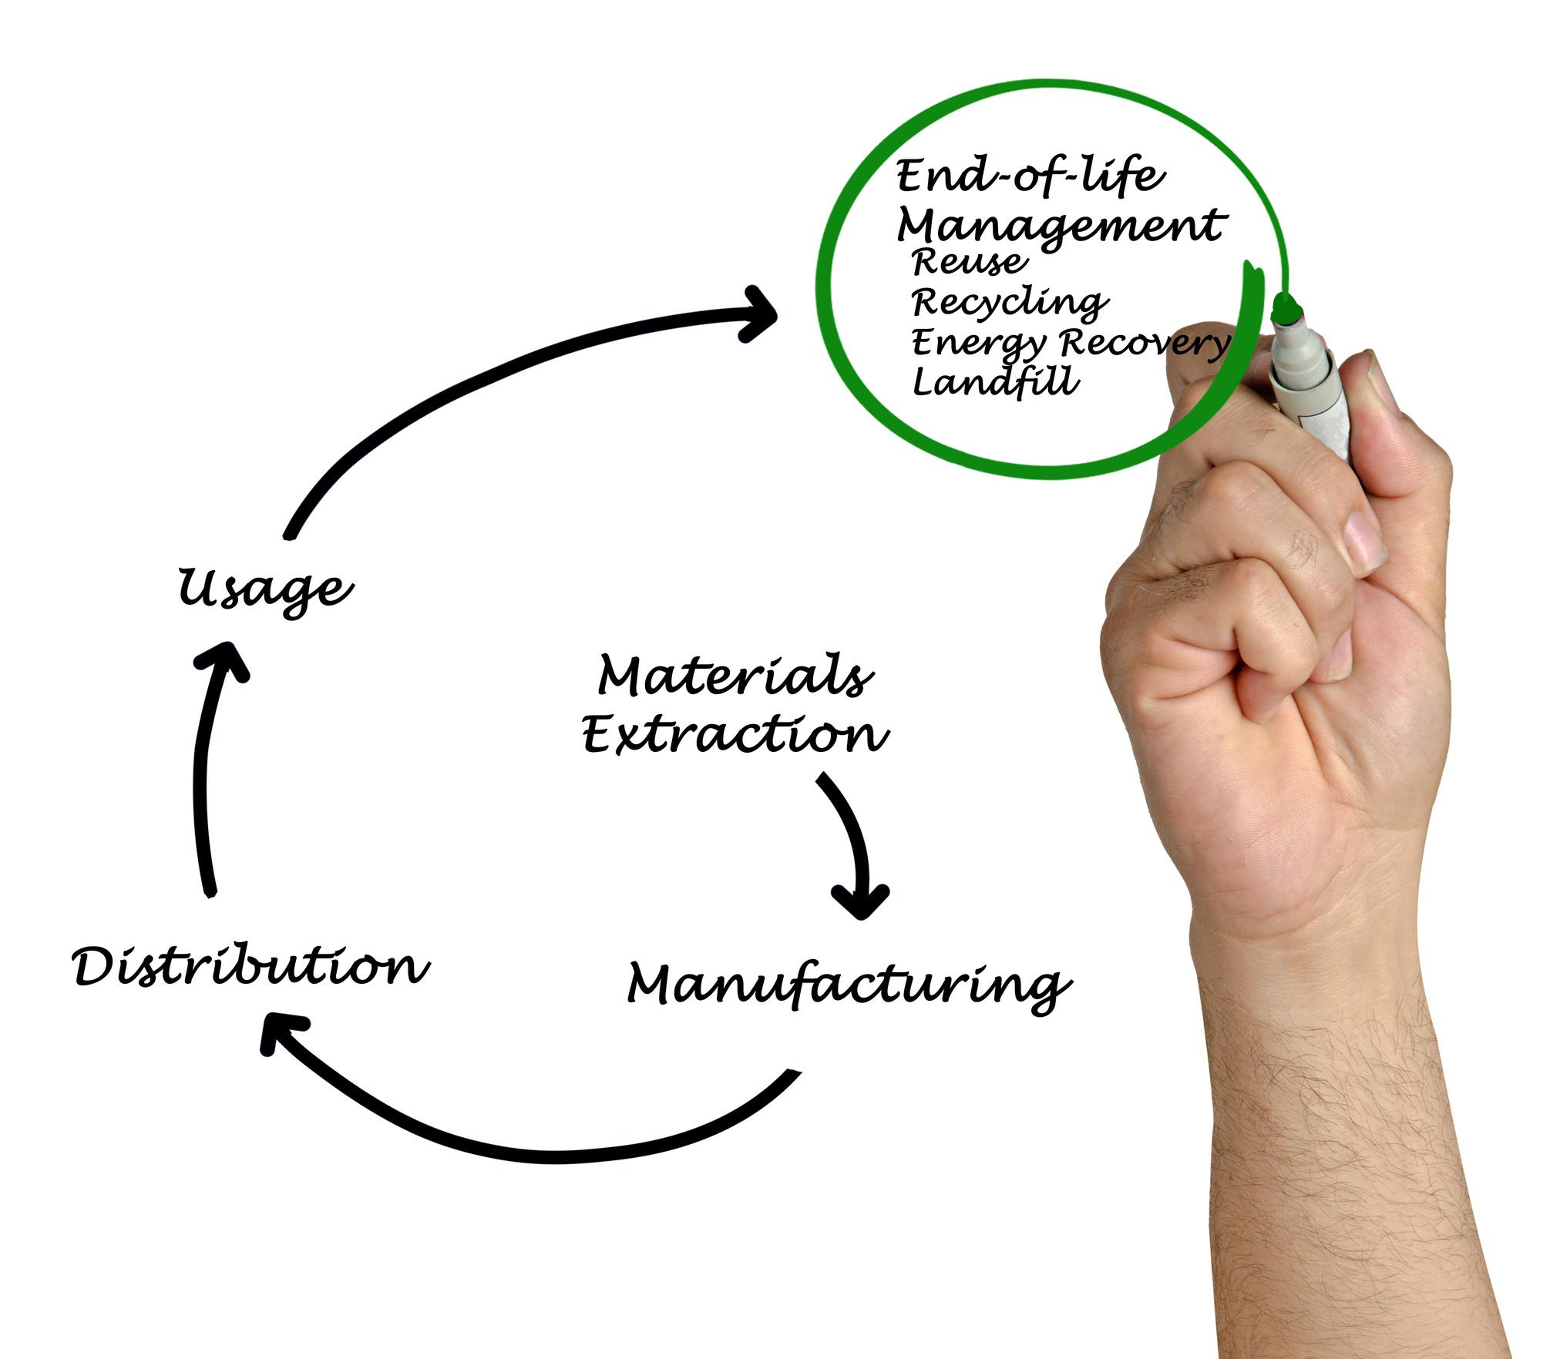
Expanding the product life cycle,
The second principle, emphasizes the importance of maximizing the value and usefulness of a product for as long as possible. The strategy includes maintenance, repair, recycling and upcycling, allowing products to be used or converted into new products.
The third principle is the regeneration of natural systems, which includes the use of renewable materials and the processes that support them

Slide 8






Reusing and recycling products would slow down the use of natural resources, reduce landscape and habitat disruption and help to limit biodiversity loss.
a reduction in total annual greenhouse gas emissions. According to the European Environment Agency, industrial processes and product use are responsible for 9.10% of greenhouse gas emissions in the EU, while the management of waste accounts for 3.32%.
Creating more efficient and sustainable products from the start would help to reduce energy and resource consumption, as it is estimated that more than 80% of a product's environmental impact is determined during the design phase.
A shift to more reliable products that can be reused, upgraded and repaired would reduce the amount of waste. Packaging is a growing issue and, on average, the average European generates nearly 180 kilos of packaging waste per year. The aim is to tackle excessive packaging and improve its design to promote reuse and recycling.

Slide 9

Economic Opportunities from the Circular Economy
Reducing the use of new raw materials and using recycled materials can significantly reduce production costs and increase profitability for the company
1
In addition to recycling, product improvement and the development of environmentally friendly materials, the circular economy creates jobs in other new sectors
2
Innovation and competitive advantage in the marketplace can be gained through the development of new products that are more durable, repairable, or easily recyclable
3

Slide 10
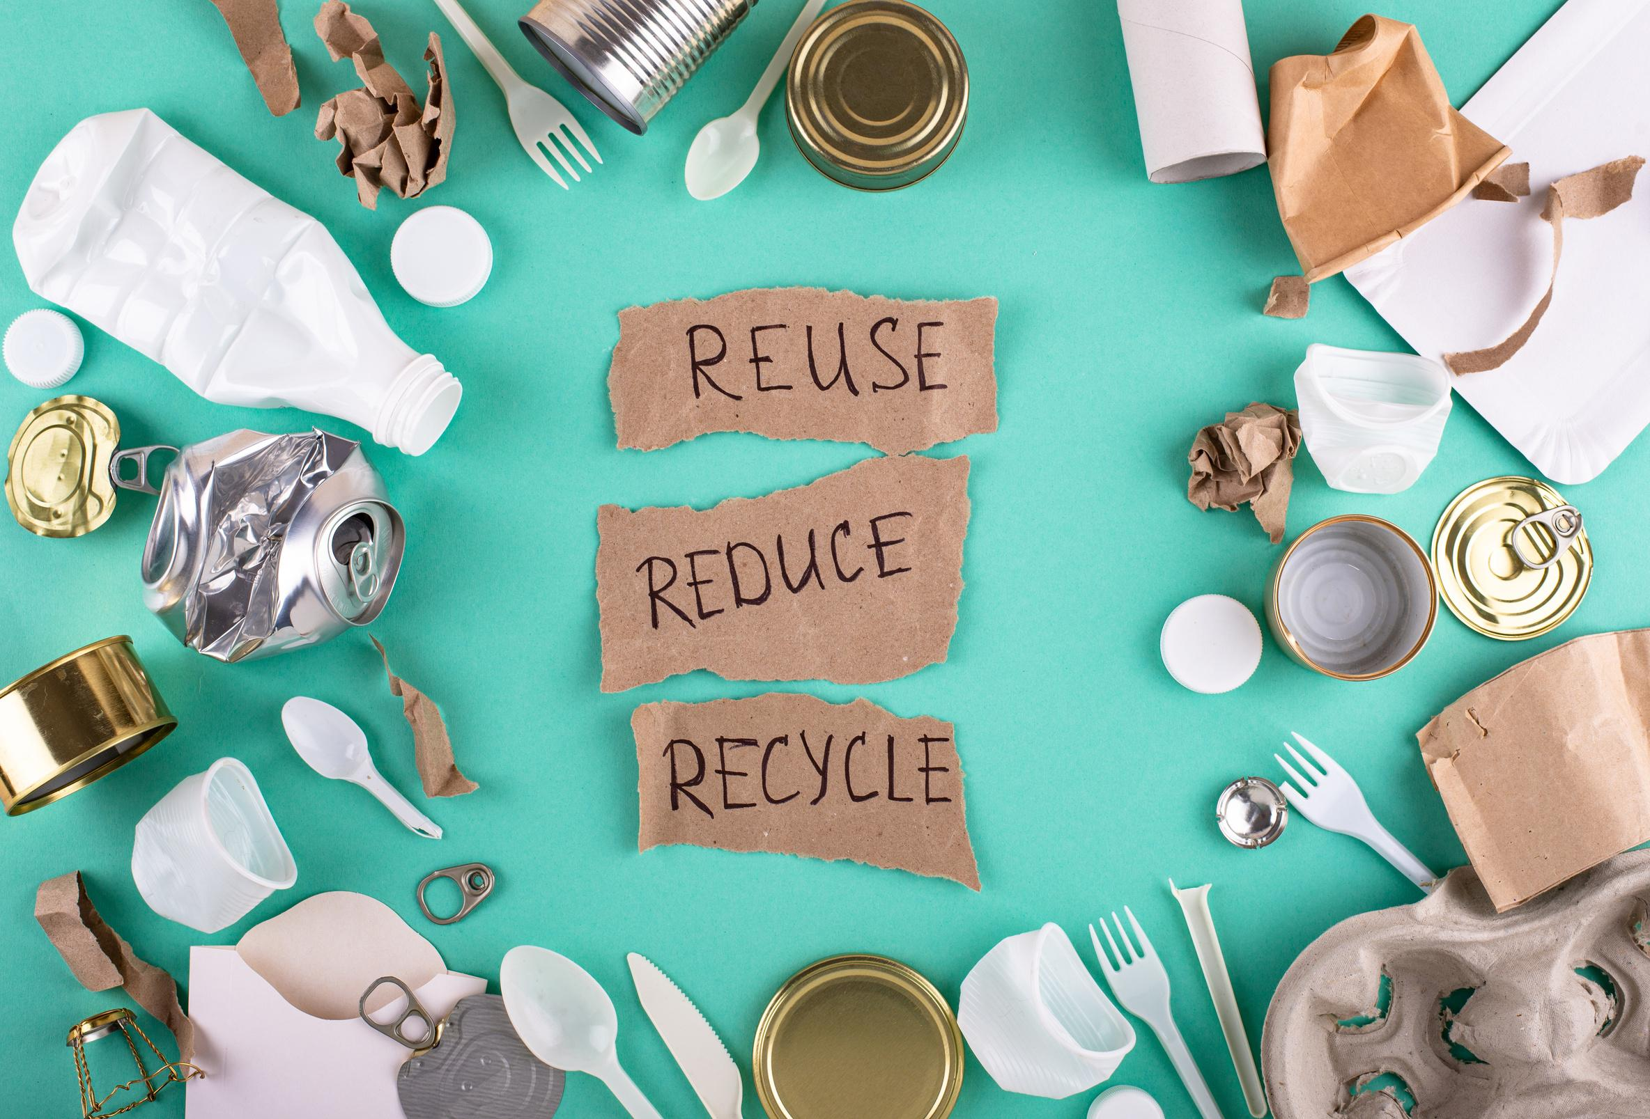

Consumer Contribution in the Circular Economy
By choosing products that are durable and repairable, consumers can contribute to the circular economy
Consumers can reduce waste and resource use by avoiding unnecessary items and choosing quality over quantity

Slide 11

The Role of Technology in the Circular Economy
The implementation of a circular economy is assisted and accelerated by technology through the creation of innovations that enable the use of resources more efficiently and sustainably. For example, technologies such as big data and the Internet of Things can be used to track and optimize product life cycles, facilitate recycling processes, and reduce waste through careful monitoring

Slide 12

Close collaboration between various sectors will mark the future of a circular economy
The Future of the Circular Economy
Policies that encourage circular economy practices will be developed by the government
The future of the circular economy offers a vision of a world where economic growth no longer depends on the exploitation of limited natural resources, but on innovation and the efficient use of materials
Consumers will become more aware of the importance of a circular economy

Slide 13
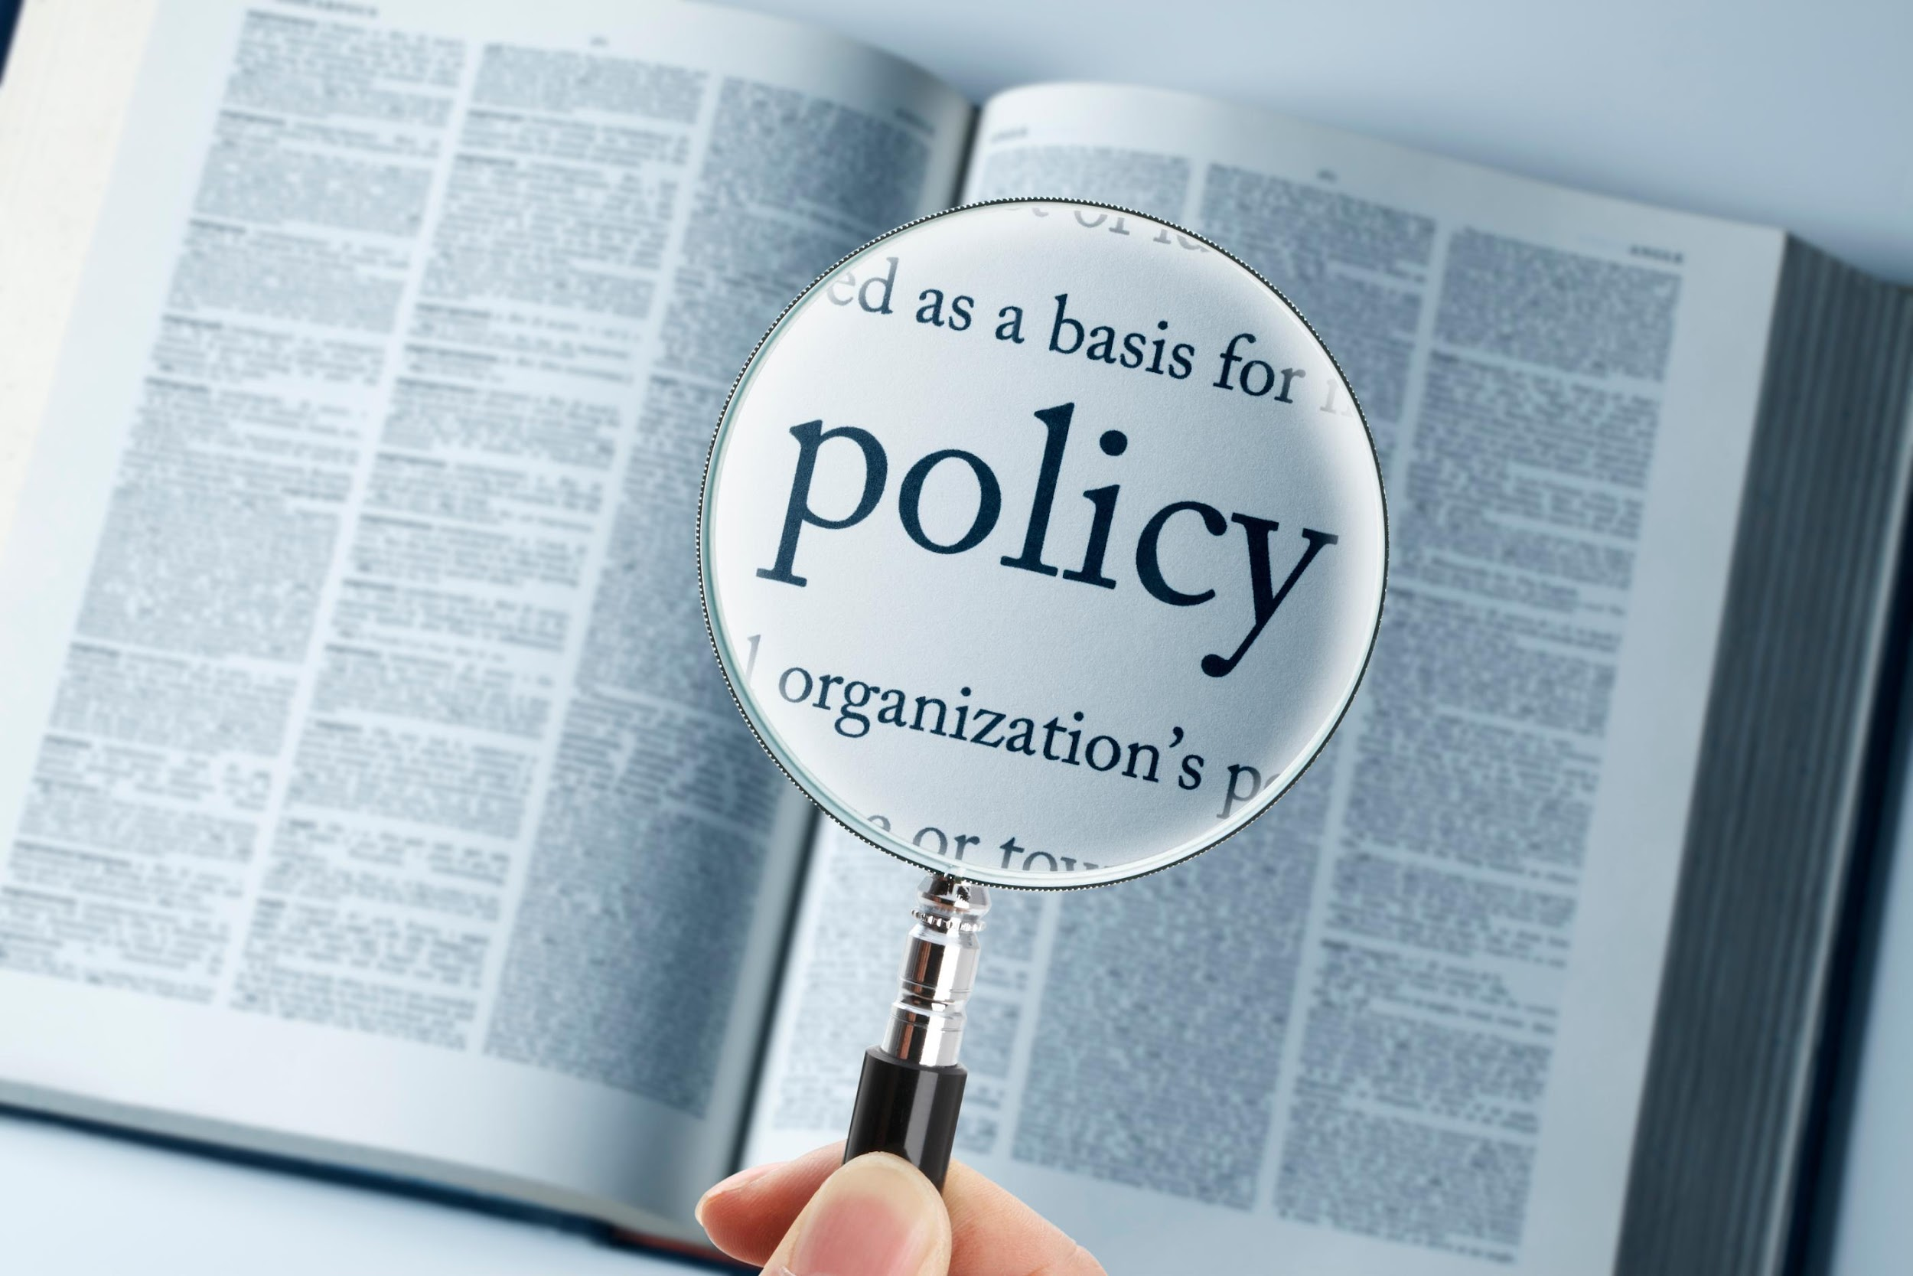




In March 2020, the European Commission presented the circular economy action plan, which aims to promote more sustainable product design, reduce waste and empower consumers, for example by creating right to repair). There is a focus on resource intensive sectors, such as electronics and ICT, plastics, textiles and construction
In February 2021, the Parliament adopted a resolution on the new circular economy action plan demanding additional measures to achieve a carbon-neutral, environmentally sustainable, toxic-free and fully circular economy by 2050, including tighter recycling rules and binding targets for materials use and consumption by 2030
In March 2022, the Commission released the first package of measures to speed up the transition towards a circular economy, as part of the circular economy action plan. The proposals include boosting sustainable products, empowering consumers for the green transition, reviewing construction product regulation, and creating a strategy on sustainable textiles.
In November 2022, the Commission proposed new EU-wide rules on packaging. It aims to reduce packaging waste and improve packaging design, with for example clear labelling to promote reuse and recycling; and calls for a transition to bio-based, biodegradable and compostable plastics.

Slide 14
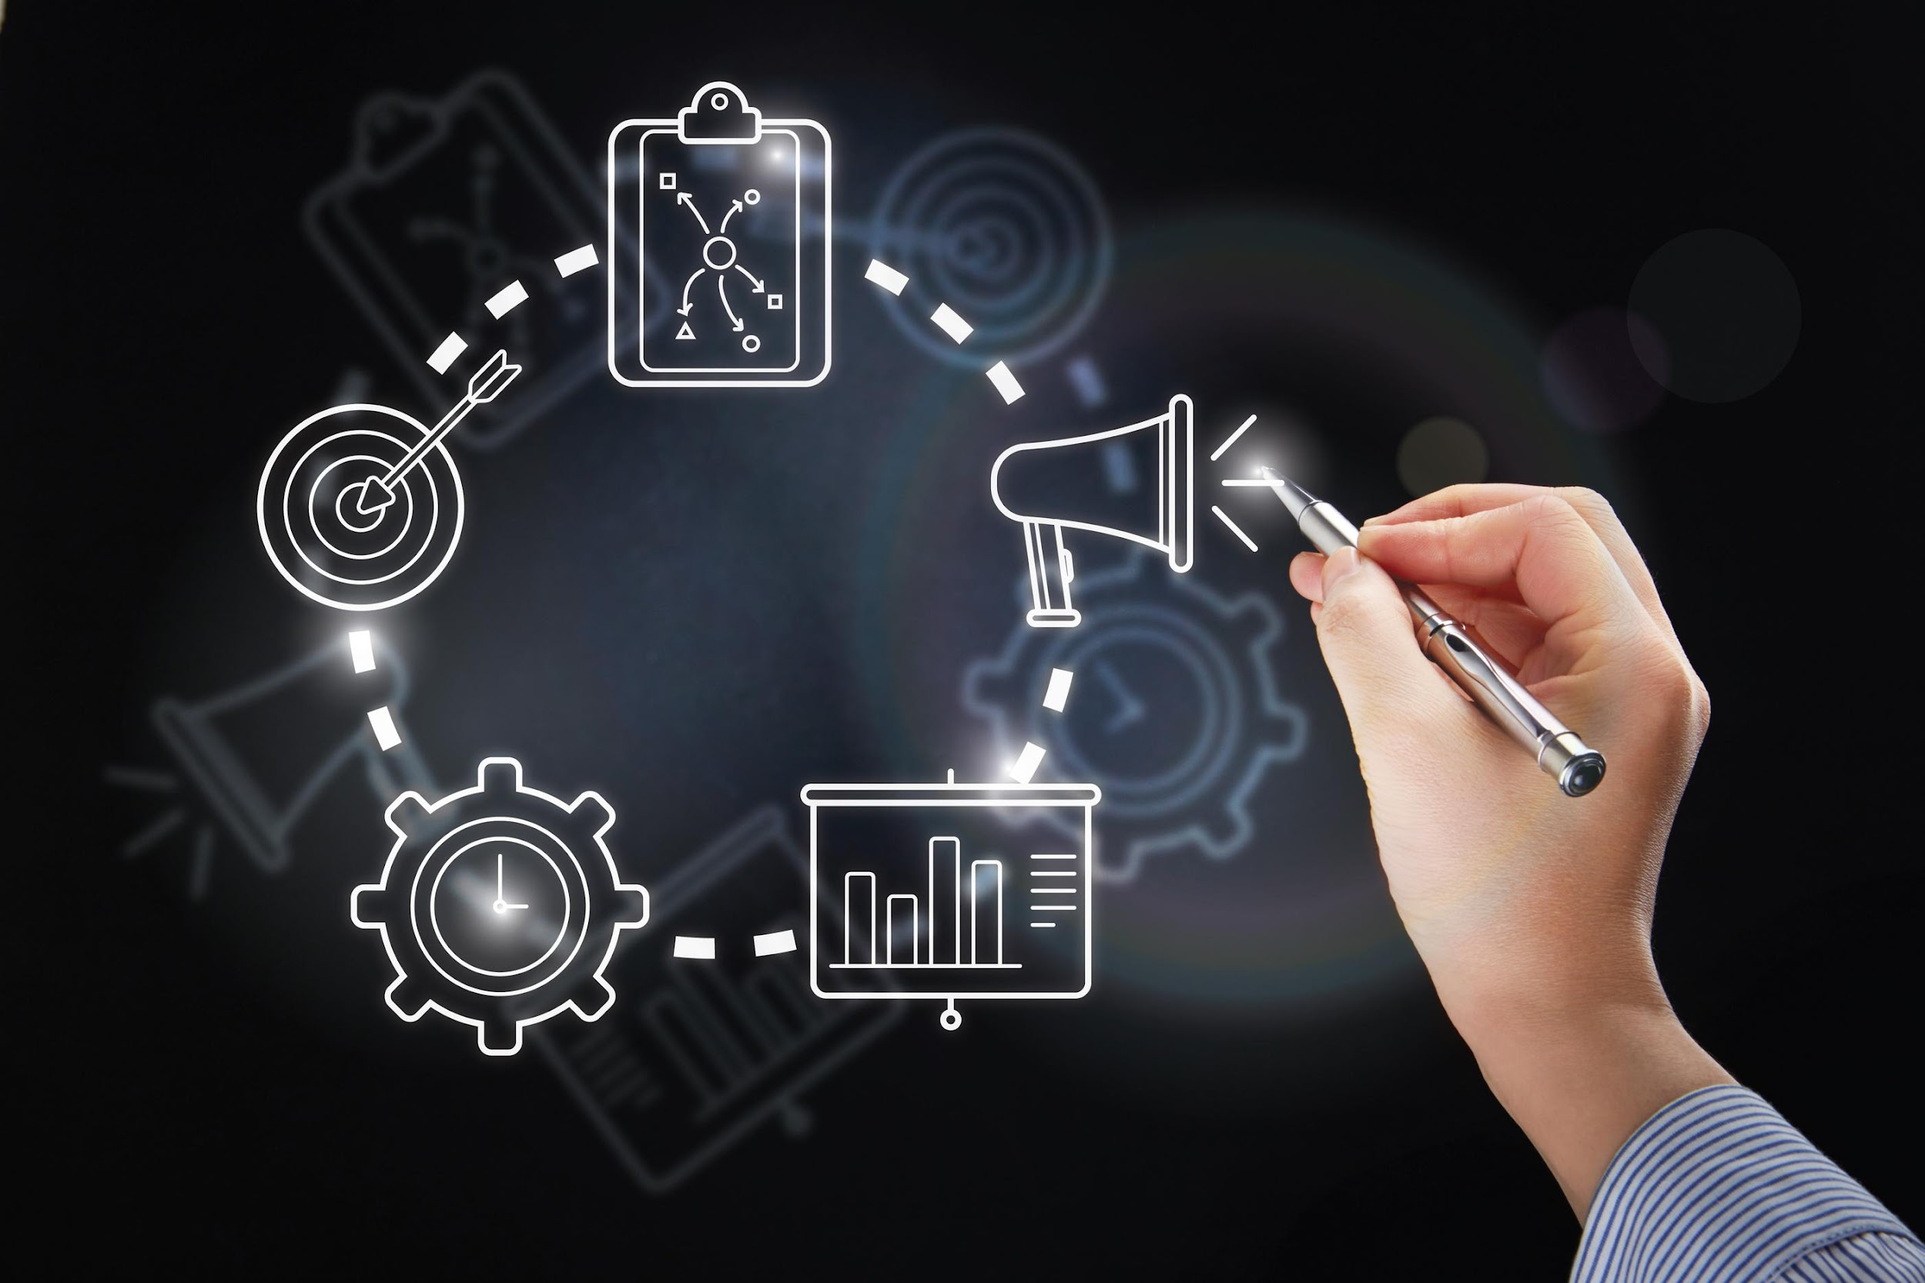
cea
Objectives
Measures that will be introduced under the new action plan aim to
  make sustainable products the norm in the EU
  empower consumers and public buyers
  focus on the sectors that use most resources and where the potential for circularity is high such as: electronics and ICT, batteries and vehicles, packaging, plastics, textiles, construction and buildings, food, water and nutrients
  ensure less waste
  make circularity work for people, regions and cities
  lead global efforts on circular economy

Slide 15

Thank You
To everyone who is present here

